Slide 1
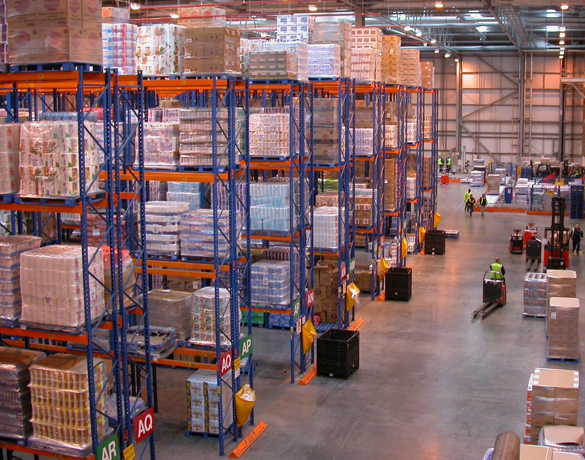
Writing distributed tasks Using Celery

Slide 2
Agenda
Mini example
Celery
AMQP

Slide 3

Distributed everywhere
Jenkins
OBS
BOSS
iTest

Slide 4


Part 1: Mini Jenkins via Celery
As an example, we are trying to implement a mini Jenkins by using Celery.

Slide 5
v1.0
Web app: User interface
Start real tasks in the same process of web app
Block frontend process. Even timeout
Difficult to scale up/out

Slide 6


Slide 7
v2.0
Start tasks in background thread/process
Block frontend process. Even timeout
Still difficult to scale out

Slide 8
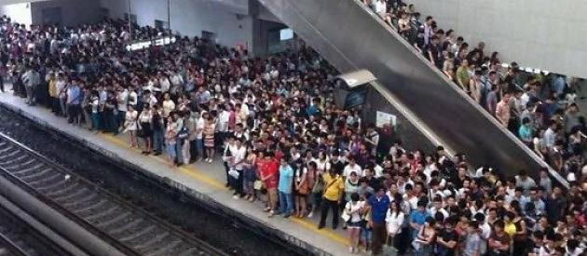



Slide 9
v3.0
Put tasks into message queue. Producer/Consumer pattern
Block frontend process. Even timeout
Still difficult to scale out
Choose message broker: rabbitmq, redis, zmq …
Choose Python library: pika, carrot, amqplib …
Maintain boring producer and consumer template code. (ORM vs. MySQLdb)

Slide 10

v4.0

Slide 11
4 steps to armed with Celery
Choosing a message broker
rabbitmq
redis
http://docs.celeryproject.org/en/latest/getting-started/brokers/index.html#broker-overview
Choosing a result backend
rabbitmq
mysql
http://docs.celeryproject.org/en/latest/userguide/tasks.html#task-result-backends
Running celery workers
$ celery -A tasks worker --loglevel=info
Calling the task
result = task.delay(x, y, z)
Example:
https://github.com/huanghao/ppt/blob/master/MiniJenkinsViaCelery/webapp.py#L69
https://github.com/huanghao/ppt/blob/master/MiniJenkinsViaCelery/tasks.py#L32

Slide 12
Part 2: Celery 3.1.7
Lines code less than 30k (53k including tests)
http://docs.celeryproject.org/en/latest/faq.html#does-celery-really-consist-of-50-000-lines-of-code
https://github.com/celery/celery/graphs/contributors

Slide 13
Features
Canvas: Designing Workflows
Group/chain/chord/map/starmap/chunks
Periodic Tasks
$ celery beat
HTTP Callback Tasks (WebHooks)
http://docs.celeryproject.org/en/latest/userguide/remote-tasks.html#ruby-on-rails-webhook-example
GET http://example.com/mytask/?arg1=a&arg2=b&arg3=c
{'status': 'success', 'retval': …}
{'status': 'failure': 'reason': 'Invalid moon alignment.'}
>>> from celery.task.http import URL
>>> res = URL('http://example.com/multiply').get_async(x=10, y=10)
>>> res.get()
100
Routing tasks (AMQP)
Monitoring
celery flower/celery events/Munin

Slide 14
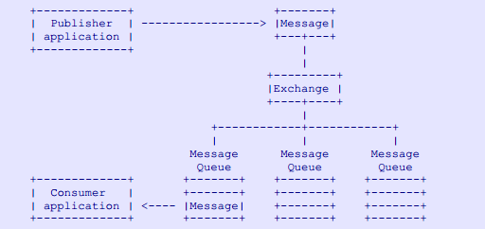
Part 3: AMQP

Slide 15

Queue
Private or shared
Durable or temporary
Client-named or server-named
Store-and-forward queue
Temporary reply queue
Pub-sub

Slide 16
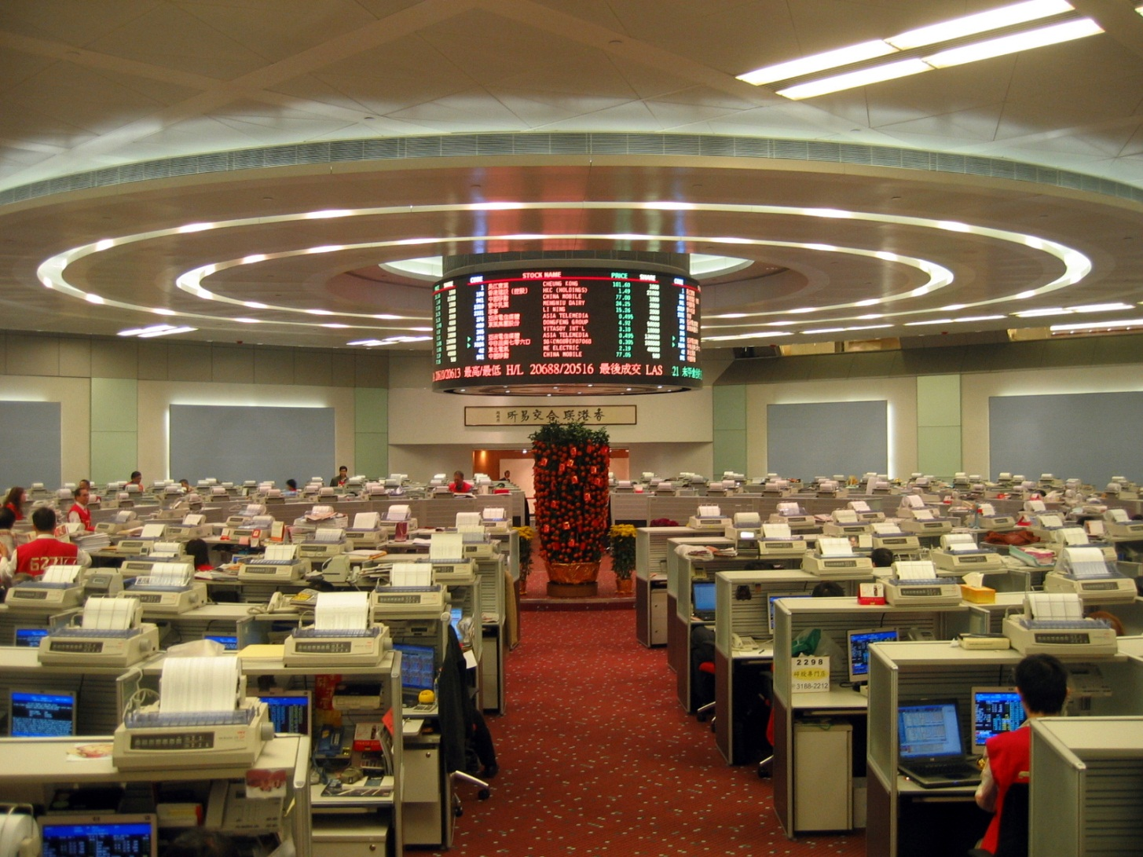
Exchange

Slide 17
The Exchange
An exchange accepts messages from a producer application and routes these to message queues according to pre-arranged criteria. These criteria are called `"bindings"`.
Exchanges are matching and routing engines.
Exchanges never store messages.
Routing key
direct: for point-to-point routing
topic: for topic pub-sub routing

Slide 18
Analogy to Email
An AMQP message is analogous to email message
A message queue is like a mailbox
A consumer is like a mail client that fetches and deletes email
A exchange is like a MTA (mail transfer agent) that inspects email and decides, on the basis of routing keys and tables, how to send the email to one or more mailboxes
A routing key corresponds to an email To: or Cc: or Bcc: address, without the server information (routing is entirely internal to an AMQP server)
Each exchange instance is like a separate MTA process, handing some email sub-domain, or particular type of email traffic
A binding is like an entry in a MTA routing table

Slide 19
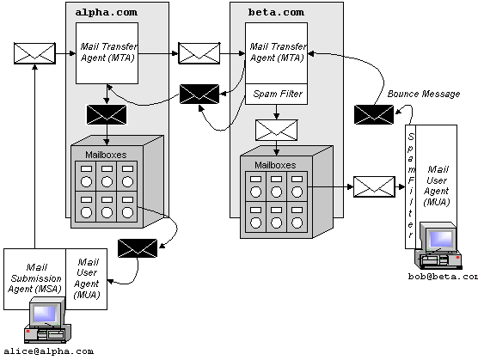

Slide 20
Thanks !

